Slide 1
Introduction to Statistical Methods
ISM Team

Slide 2
Overview of the course
& Basic Probability & Statistics (CS -1)
(Session 1: 12th /13th Nov 2022)

Slide 3
Overview of the course
M 1 : Basic Probability & Statistics
M 2 : Conditional Probability & Bayes’ theorem
M 3 : Probability Distributions
M 4 : Hypothesis Testing
M 5 : Prediction & Forecasting
M 6 : Prediction & Forecasting Gaussian Mixture model &
Expectation Maximization

Slide 4
TEXT BOOKS
T1 : Statistics for Data Scientists, An introduction to probability
,statistics and Data Analysis, Maurits Kaptein et al,Springer 2022
T2 : Probability and Statistics for Engineering and Sciences,
8th Edition, Jay L Devore, Cengage Learning
T3 : Introduction to Time Series and Forecasting, Second Edition,
Peter J Brockwell, Richard A Davis, Springer.

Slide 5
Evaluation Components
No | Name | Type | Weight
EC-1(a) | Quizzes – 1 & 2 | Online | 10%
EC-1(b) | Assignments - 2 | Online | 20%
EC-2 | Mid-Semester Test | Closed Book | 30%
EC-3 | Comprehensive Exam | Open Book | 40%

Slide 6
Module 1: (Basic Probability & Statistics)
Contact Session | List of Topic Title | Reference
CS - 1 | Measures of Central Tendency & Measures of Variability, Data – Symmetric & Asymmetric, outlier detection, 5 point summary, Introduction to probability | T1 & T2

Slide 7
“Statistical thinking will be one day as necessary for efficient citizenship as the ability to read and write”
H G Wells

Slide 8
Statistics
Statistics may be defined as science that is employed to
Collect the data
Present and organize the data in a systematic manner
Analyse the data
Infer about the data
Take decision from the data.
In other words, Statistics can also be defined as numerical data with a view to analyse it.

Slide 9
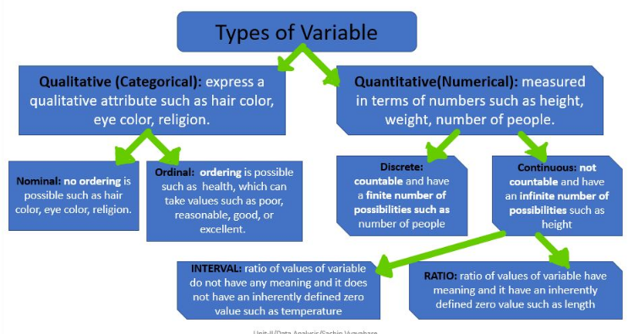

Slide 10
Measures of Central Tendency
Measure of central tendency provides a very convenient way of describing a set of scores with a single number that describes the PERFORMANCE of the group.
Also defined as a single value that is used to describe the “center” of the data.
Three commonly used measures of central tendency:
Mean
Median
Mode

Slide 11
Mean
Also referred as the “arithmetic average”
The most commonly used measure of the center of data
Numbers that describe what is average or typical of the distribution
Computation of Sample Mean:
= Σ Y/ N = (Y1 + Y2 + Y3 + … Yn) / N where
“Y bar” equals the sum of all the scores, Y, divided by the number of scores, N.
Computation of the Mean for grouped Data
Where f Y = a score multiplied by its frequency

Slide 12
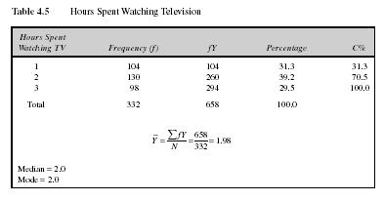
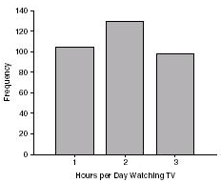
Mean: Grouped Scores
Data of Children watching TV in Bengaluru

Slide 13
Mean
Properties
It measures stability. Mean is the most stable among other measures of central tendency because every score contributes to the value of the mean.
It may easily affected by the extreme scores.
The sum of each score’s distance from the mean is zero.
It can be applied to interval level of measurement
It may not be an actual score in the distribution
It is very easy to compute.

Slide 14
Mean
When to Use the Mean
Sampling stability is desired.
Other measures are to be computed such as standard deviation, coefficient of variation and skewness

Slide 15
The Mode
The category or score with the largest frequency (or percentage) in the distribution.
The mode can be calculated for variables with levels of measurement that are: nominal, ordinal, or interval-ratio.
Example:
Number of Votes for Candidates for Lok Sabha MP. The mode, in this case, gives you the “central” response of the voters: the most popular candidate.
Candidate A – 11,769 votes The Mode:
Candidate B – 39,443 votes “Candidate C”
Candidate C – 78,331 votes

Slide 16
Mode
Properties
It can be used when the data are qualitative as well as quantitative.
It may not be unique.
It is not affected by extreme values.
When to Use the Mode
When the “typical” value is desired.
When the data set is measured on a nominal scale

Slide 17
The Median
The score that divides the distribution into two equal parts, so that half the cases are above it and half below it.
The median is the middle score, or average of middle scores in a distribution.
Fifty percent (50%) lies below the median value and 50% lies above the median value.
It is also known as the middle score or the 50th percentile.

Slide 18



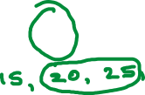
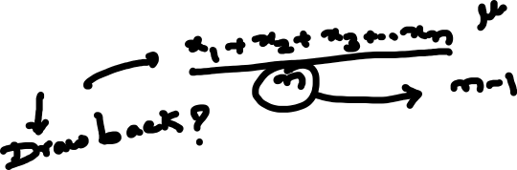
Measures of central tendency
The mean
the median
the mode

Slide 19
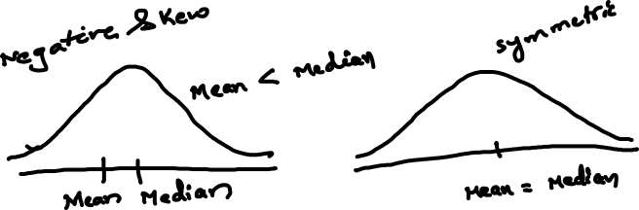
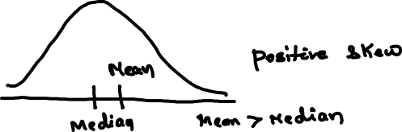
Data : Symmetrical and Asymmetrical

Slide 20
Shape of the distribution of data
Symmetrical : Mean is equal to median
Skewed
Negatively : mean < median
Positively : mean > median
Bimodal : has two distinct modes
Multi-modal : has more than 2 distinct modes
Notes:
Draw Examples on the board

Slide 21
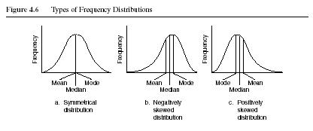
Distribution Shape

Slide 22
Sl. No. | X₁
1 | 2
2 | 8
3 | 5
4 | 3
5 | 7
6 | 8
7 | 5
8 | 2
9 | 5
Total | 45
X₂
1
15
5
5
6
3
5
2
3
45

Slide 23
Sl. No. | X₁
1 | 2
2 | 8
3 | 5
4 | 3
5 | 7
6 | 8
7 | 5
8 | 2
9 | 5
Total | 45
Statistical measures | Group 1
Mean | 5
Median | 5
Mode | 5

Slide 24
Sl. No. | X₂
1 | 1
2 | 15
3 | 5
4 | 5
5 | 6
6 | 3
7 | 5
8 | 2
9 | 3
Total | 45
Statistical measures | Group 2
Mean | 5
Median | 5
Mode | 5

Slide 25
Sl. No. | X₁
1 | 2
2 | 8
3 | 5
4 | 3
5 | 7
6 | 8
7 | 5
8 | 2
9 | 5
Total | 45
X₂
1
15
5
5
6
3
5
2
3
45
Statistical measures | Group 1 & 2
Mean | 5
Median | 5
Mode | 5

Slide 26


Slide 27
Do we need any other measure?
Answer: Yes
Measures of variability
Three Measures of Variability:
The Range
The Variance
The Standard Deviations

Slide 28
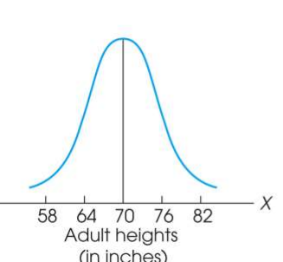
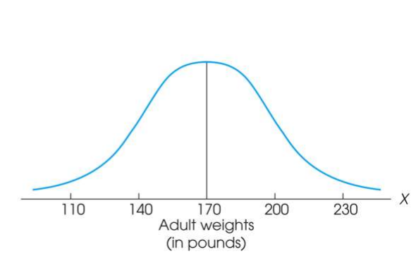
Measure of Variability
Variability can be defined several ways:
A quantitative distance measure based on the differences between scores
Describes distance of the spread of scores or distance of a score from the mean
Purposes of Measure of Variability:
Describe the distribution
Measure how well an individual score represents the distribution

Slide 29
The Three Measures
Three Measures of Variability:
The Range
The Variance
The Standard Deviations

Slide 30
The Ranges
The distance covered by the scores in a distribution – From smallest value to highest value
For continuous data, real limits are used
Based on two scores, not all the data – An imprecise, unreliable measure of variability
Range = URL for X_{max} - LRL for X_{min}
Example: For a set of scores: 7, 2, 7, 6, 5, 6, 2
Range = Highest Score minus Lowest score = 7 - 2 = 5

Slide 31
The Standard Deviation
Most common and most important measure of variability is the standard deviation
A measure of the standard, or average, distance from the mean
Describes whether the scores are clustered closely around the mean or are widely scattered
Calculation differs for population and samples
Variance is a necessary companion concept to standard deviation but not the same concept

Slide 32
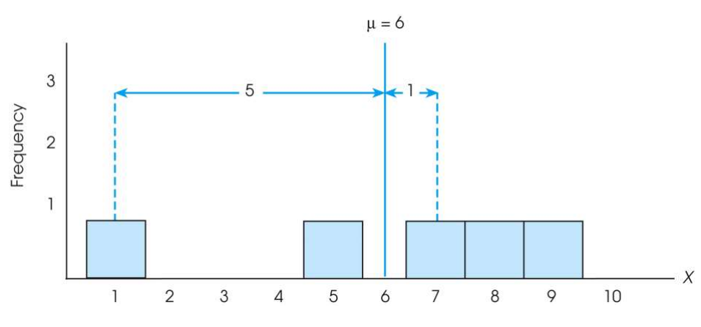

The Standard Deviation
Exercise : Find out the deviations of all the data points with the mean….and then find the ‘mean deviation’.

Slide 33

The Standard Deviation
Mean deviations will always be ‘zero’ !
(because Mean is a balance point)
Then, how do you find ‘Standard Deviation’ ?
Need a new strategy

Slide 34

The Standard Deviation
New Strategy :
First square each deviation score
Then sum the Squared Deviations (SS)
Average the squared deviations
Mean Squared Deviation is known as “Variance”
Variability is now measured in squared units

Slide 35
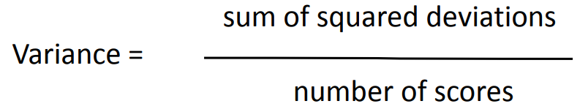
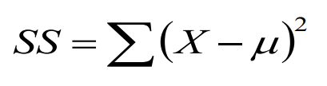
The Variance
Variance equals mean (average) squared deviation (distance) of the scores from the mean
where

Slide 36
The Population Variance
Population variance equals mean (average) squared deviation (distance) of the scores from the population mean
Variance is the average of squared deviations, so we identify population variance with a lowercase Greek letter sigma squared: σ 2
Standard deviation is the square root of the variance, so we identify it with a lowercase Greek letter sigma: σ

Slide 37
Sl. No. | X₁
1 | 2
2 | 8
3 | 5
4 | 3
5 | 7
6 | 8
7 | 5
8 | 2
9 | 5
Total | 45
Statistical measures | Group 1
Mean | 5
Median | 5
Mode | 5

Slide 38
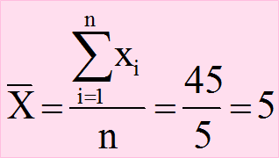
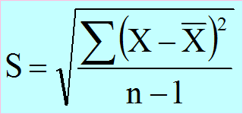
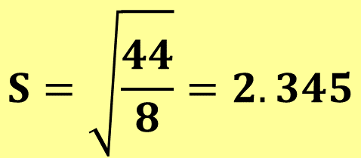
Sl. No. | X₁
1 | 2
2 | 8
3 | 5
4 | 3
5 | 7
6 | 8
7 | 5
8 | 2
9 | 5
Total | 45
$$S=\sqrt{\frac{44}{8}}=2.345$$

Slide 39
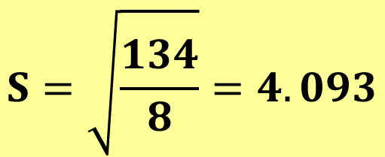
Sl. No. | X₂
1 | 1
2 | 15
3 | 5
4 | 5
5 | 6
6 | 3
7 | 5
8 | 2
9 | 3
Total | 45
$$S=\sqrt{\frac{134}{8}}=4.093$$

Slide 40
Learning Check
If all the scores in a data set are the same, the Standard Deviation is equal to 1.00
The standard deviation measures …
(1) Sum of squared deviation scores
(2) Standard distance of a score from the mean
(3) Average deviation of a score from the mean
(4) Average squared distance of a score from the mean
True / False ?
Select the correct option

Slide 41
Solution
If all the scores in a data set are the same, they are equal to the mean and hence the deviation from mean = 0 therefore, Standard Deviation is equal to zero
The standard deviation measures …
(1) Sum of squared deviation scores
(2) Standard distance of a score from the mean
(3) Average deviation of a score from the mean
(4) Average squared distance of a score from the mean
False

Slide 42
Standard Deviation and Variance for a Sample
Goal of inferential statistics:
Draw general conclusions about population
Based on limited information from a sample
Samples differ from the population
Samples have less variability
Computing the Variance and Standard Deviation in the same way as for a population would give a biased estimate of the population values

Slide 43
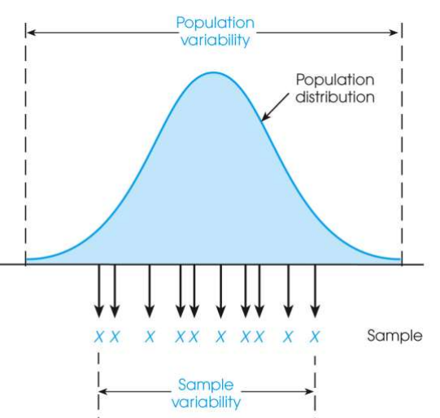
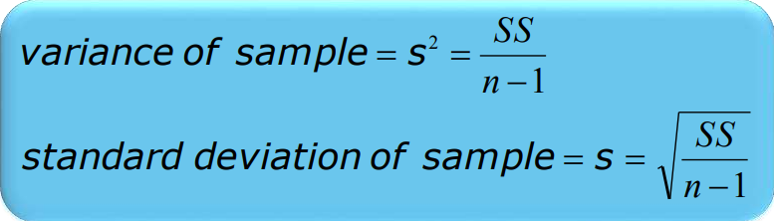
Sample Standard Deviation and Variance
Sum of Squares (SS) is computed as before
Formula for Variance has n-1 rather than N in the denominator
Notation uses s instead of σ
Population of Adult Heights

Slide 44
Degrees of Freedom
Population variance
Mean is known
Deviations are computed from a known mean
Sample variance as estimate of population
Population mean is unknown
Using sample mean restricts variability
Degrees of freedom
Number of scores in sample that are independent and free to vary
Degrees of freedom (df) = n – 1

Slide 45
Learning Check
Select the correct option
A sample of four scores has SS = 24. What is the variance?
The variance is 6
The variance is 7
The variance is 8
The variance is 12
A sample systematically has less variability than a population
The standard deviation is the distance from the Mean to the farthest point on the distribution curve
True / False ?
True / False ?

Slide 46
Solution
Select the correct option
A sample of four scores has SS = 24. What is the variance?
The variance is 6
The variance is 7
The variance is 8
The variance is 12
Extreme scores affect variability, but are less likely to be included in a sample
The standard deviation extends from the mean approximately halfway to the most extreme score
True
False

Slide 47
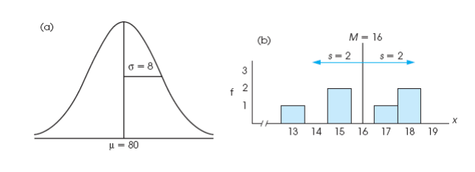
Descriptive Statistics
A standard deviation describes scores in terms of distance from the mean
Describe an entire distribution with just two numbers (M and s)
Reference to both allows reconstruction of the measurement scale from just these two numbers
Means and standard deviations together provide extremely useful descriptive statistics for characterizing distributions

Slide 48
Five point summary of Data
The five number summary of data includes 5 items:
Minimum.
Q1 (the first quartile, or the 25% mark).
Median.
Q3 (the third quartile, or the 75% mark).
Maximum.

Slide 49
Interquartile range (IQR)
It is measure of Variation
Also Known as Midspread : Spread in the Middle 50%
Difference Between Third & First Quartiles:
Not Affected by Extreme Values
Interquartile Range = IQR = Q₃ – Q₁
Data in Ordered Array: 11 12 13 16 16 17 17 18 21
1•(9 + 1)
Position of Q₁
=
= 2.50,
Q₁
=12.5
4
3•(9 + 1)
Position of Q₃
=
= 7.50,
Q₃
=17.5
4
Interquartile Range = IQR= Q₃ – Q₁ = 17.5 - 12.5 = 5

Slide 50
Box and Whisker plot
97.5th Centile
75th Centile
Q₁
MEDIAN
(50th centile)
Q₂
25th Centile
Q₃
Inter-quartile range
2.5th Centile

Slide 51
Box and Whisker plot
IQR = Q₃ – Q₁
Q₁-1.5 IQR
Q₃+1.5 IQR
Min
Max
Q₁
Q₂
Q₃
Outlier
Outlier

Slide 52
Box-and-Whisker plot
IQR = Q₃ – Q₁
Min
Q₁-1.5 IQR
Q₃+1.5 IQR
Max
Q₁
Q₂
Q₃
Q₃+3 IQR
Q₁-3 IQR
Major Outlier
Major Outlier

Slide 53
Potential outliers
The lower limit and upper limit of a data set are given by:
Lower limit = Q₁ - 1.5 x IQR
Upper limit = Q₃ + 1.5 x IQR
Data points that lie below the lower limit or above the upper limit are potential outliers.

Slide 54
82 | 45 | 64 | 80 | 82 | 74 | 79 | 80 | 80 | 78 | 80 | 80 | 48 | 73 | 80 | 79 | 81 | 70 | 78 | 73
HW problem :
For the data set below:
(a.) Obtain and interpret the quartiles.
(b.) Determine and interpret the interquartile range.
(c.) Find and interpret the five-number(point) summary.
(d.) Identify potential outliers, if any.
(e.) Construct and interpret a boxplot.

Slide 55
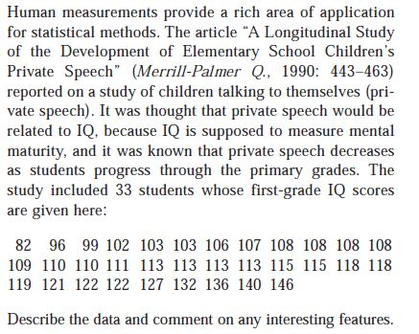
HW problem :

Slide 56
Introduction to probability

Slide 57
Random Experiment :
The term "random experiment" is used to describe any action whose
outcome is not known in advance. Here are some examples of experiments dealing with statistical data:
Tossing a coin
Counting how many times a certain word or a combination of words appears in the text of the “King Lear” or in a text of Confucius.
Counting occurrences of a certain combination of amino acids in a protein database.
Pulling a card from the deck.

Slide 58
Sample spaces and events
Sample space :
The sample space of a random experiment is a set S that includes all possible outcomes of the experiment.
If the experiment is to throw a die and record the outcome, then,
sample space is S = { 1,2,3,4,5,6}
Event : An event is a subset of sample space of the random experiment.

Slide 59
Definition of probability
Classical approach :

Slide 60
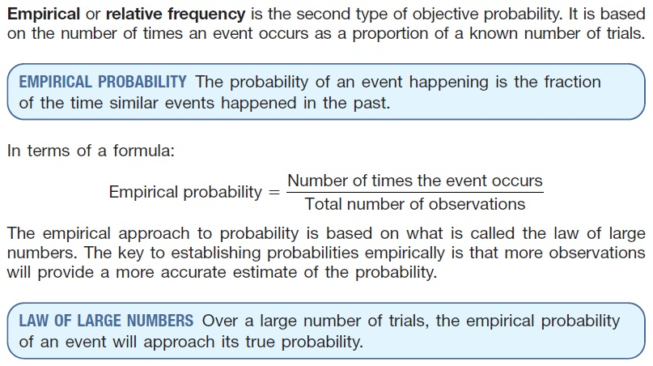
Empirical approach :

Slide 61
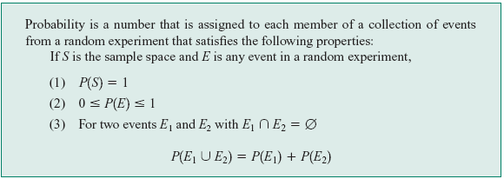
Axiomatic approach :
Definition :

Slide 62
Thank You

